Slide 1
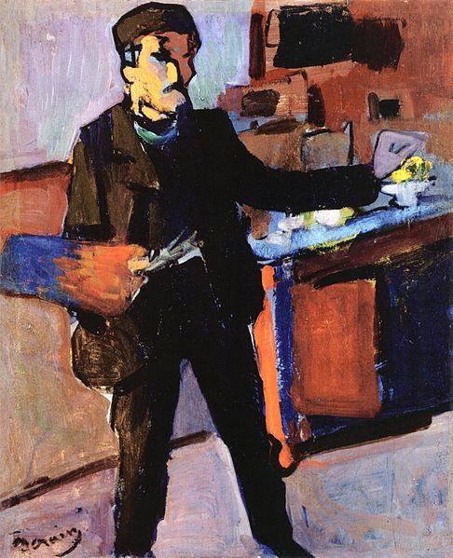
By Tommy Boss
Chapter 25 Art and Literature

Slide 2
La Belle Époque
'The Beautiful Era' lasted from 1871 to 1914, the beginning of World War I
Fueled by the second industrial revolution, La Belle Epoque was a time of prosperity in art, literature, music, and theatre
Cultural improvements were due to a variety of factors
Literacy rates increased all over Europe from 1850 to 1900, reaching 90% in countries such as Germany, France, Great Britain, and Prussia
Inventions such as the telegraph and printing improvements led to a rapid increase in communication speed and efficiency
The 'English Week' became much more popular, giving workers Sunday and half of Saturday off, allowing for much more leisure time and allowed the public to indulge in many more cultural activities like theatre

Slide 3
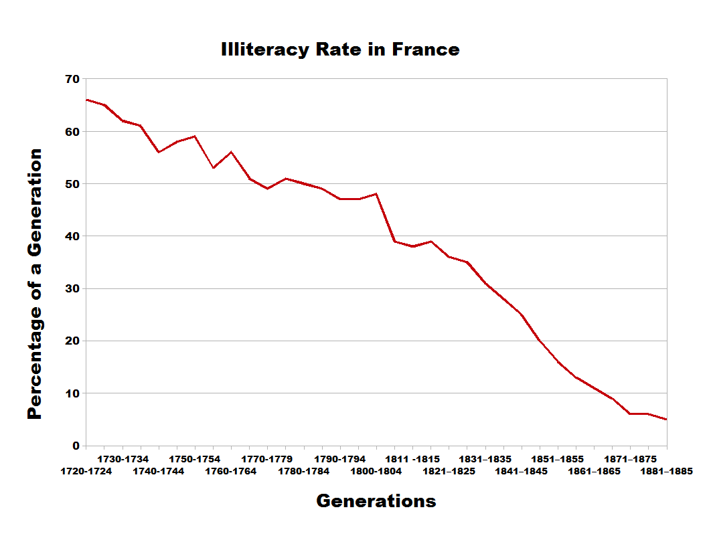
Mass Culture
As public access grew, entertainment became a more and more common profession as the demand for athletes, artists, musicians, and writers reached all time highs
Because of this massive influx of ideas and culture, many new styles of art came out of this time period
Art was generally pointed at the masses, conveying messages of everyday life and the issues and events faced by the common man

Slide 4
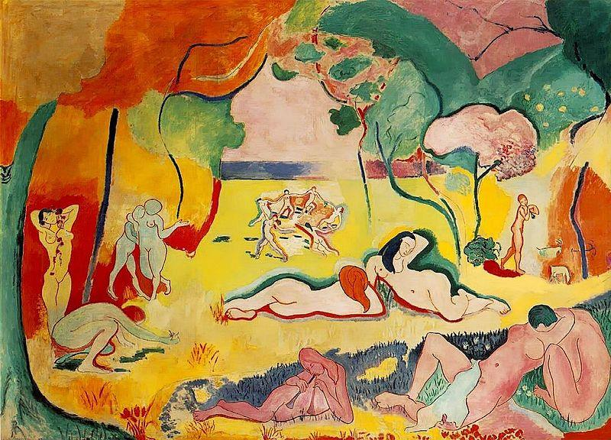
Women and Art
As inventions like the sewing machine reached the masses, women had more and more free time as well
Because of this, women became more involved in consumerism and mass entertainment, both performing and spectating
Straying from traditional domestic roles, women were increasingly heard and women's suffrage increased
As they earned a place in art and culture, products and entertainment were also made to appeal to women
Le Bonheur de Vivre (The Joy of Life) by Henri Matisse

Slide 5
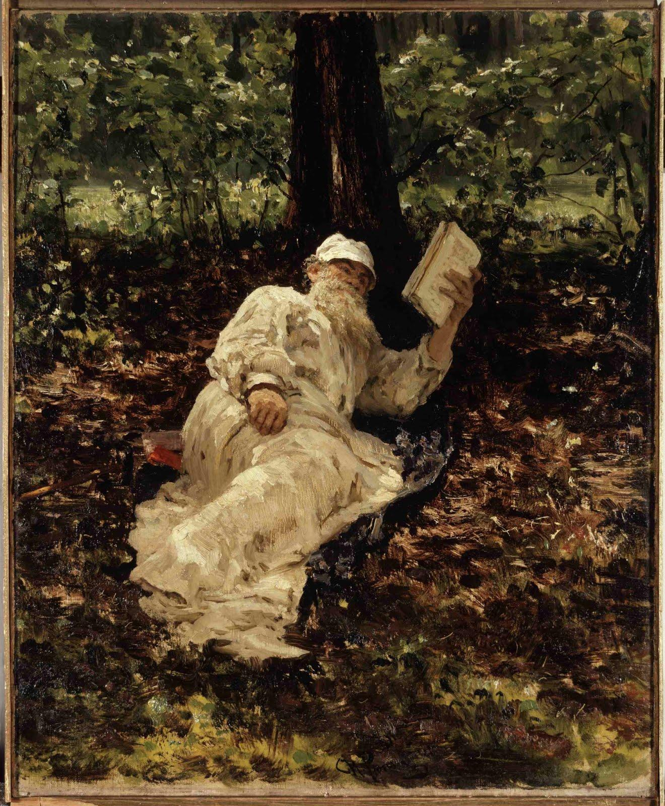
Realism in Art
As opposed to the awesome and emotional themes of romantic art, realism aimed to portray the world as it was through an objective, scientific standpoint, while rejecting the surface beauty and illegitimacy of the romantic movement
Beginning in France in the 1850s, it quickly spread through Europe and appealed to the common folk, who were increasingly involved in culture
Popular realist artists included Gustave Corbet, Jean-Francois Millet, Eduard Manat, and Thomas Eakins
Leo Tolstoy by Ilya Repin

Slide 6
Realism in Literature
"To say that a work of art is good, but incomprehensible to the majority of men, is the same as saying of some kind of food that it is very good but that most people can't eat it."
-Leo Tolstoy
The realist movement in literature followed the same values as in art and the popularity of novels grew immensely
Realist novels followed and described the common lifestyle, describing the conflicts faced by the everyday people
Great Realist writers include Guy de Maupassant (L'Heritage), Leo Tolstoy (War and Peace), and Emile Zola, who played a large role in the creation of naturalism, a response to realism

Slide 7
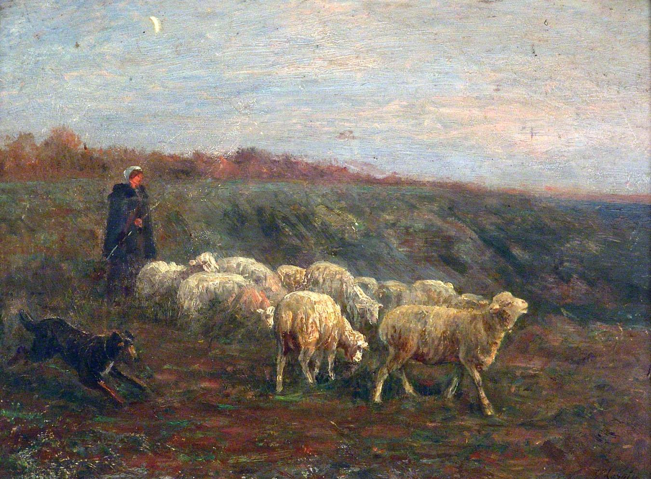
Naturalism
Naturalism is a style of art and literature that aims to compose art and literature with objective detail, but without the rejection of romantic ideals
Woman with Lambs by Albert Charpin
In many ways naturalism can be seen as a response to Rococo styles, as the naturalist thought was to present things as they are, and project beauty through the genuinity of the world as it is
Naturalism, although simple in subject matter, did not lack detail, in fact it was quite the opposite

Slide 8
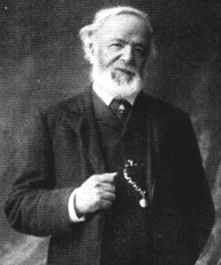
Folk Music as told by Henry Burstow
Keeping with the theme of the common man, folk songs became exceedingly popular as they told of the working life identified with by everyone, sailors to miners to soldiers alike
Henry Burstow (1826-1916) was a folk singer who perfectly embodies the movement to working class popular culture in Europe with his book Reminiscences of Horsham, which documents his songs and his experiences with culture in developing society
Songs including "Old Folks at Home," "My Good Old Father's Mill", and "Ploughman Turned Sailor" are great examples of working class culture
For his complete works and book click here

Slide 9
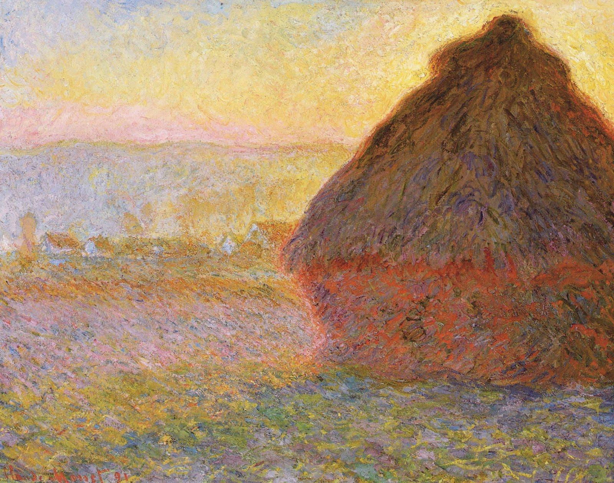
Impressionism and Subjectivity in Art
Around 1870-1880, a new movement emerged that took the scenes depicted in realist painting and applied with depictions of the changing qualities of light and unusual perspectives
Often times light and color was much more important than drawings themselves, and because of it many impressionist works are very implicative
and indirect compared
to the realist and romantic styles.
Great artists such as Monet, Renoir,
Pissaro, and Degas came out of
this movement
Haystacks (sunset0 by Claude Monet

Slide 10
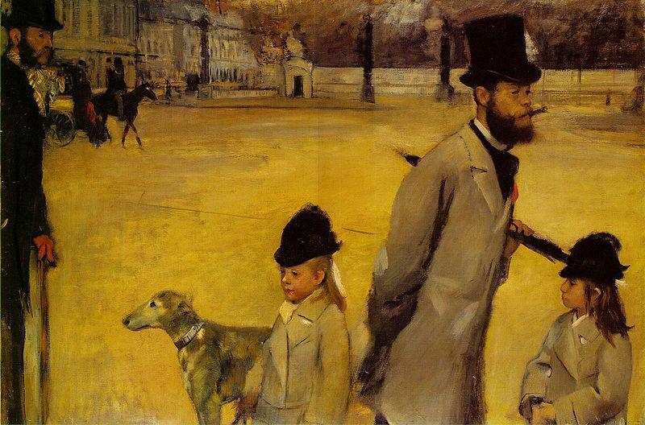
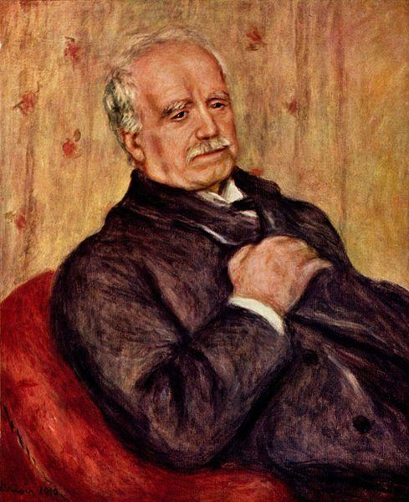
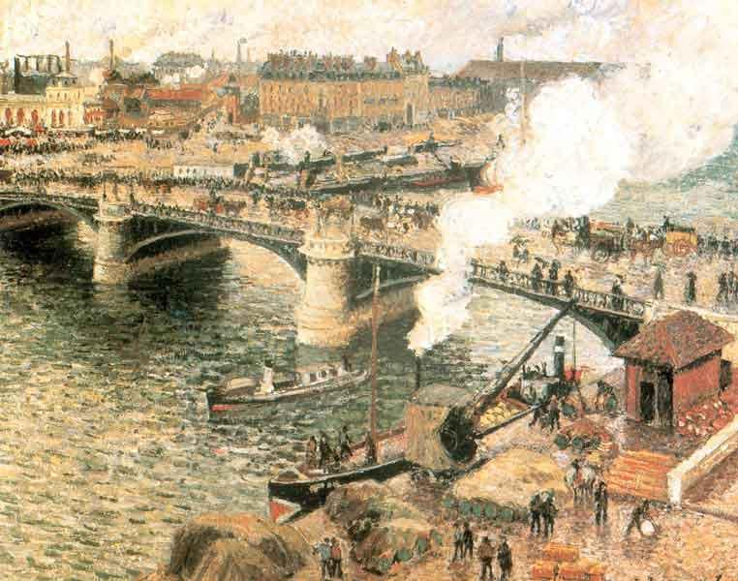
Place de la Concorde (1875) by Edgar Degas (Top Left)
Portrait of Paul Derand-Reul (1910) by Pierre Auguste-Renoir (Bottom Right)
Point Boieldieu in Rouen, Rainy Weather (1896) by Camille Pissaro (Bottom Left)
For a great video on impressionist painting click here

Slide 11
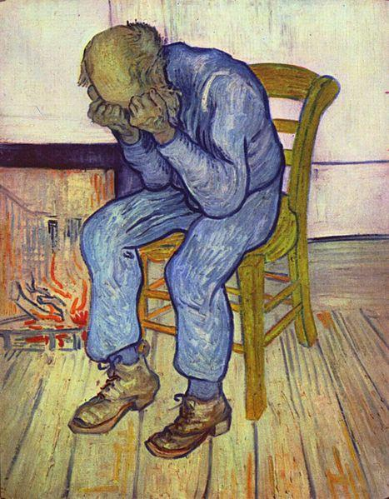
Post-Impressionism and Van Gogh
Post-Impressionism is a style that takes from Impressionist works the subject matter and focus on color and lighting, but removes the limitations in favor of distortion and exaggeration for emphasis and artistic expression
Instead of confining the pieces to the dimensions in reality, post-impressionism often uses the coloring effects used by impressionist painters to give life and emotion to the often very geometric drawings
Van Gogh (1853-1890), a Dutch painter, the greatest to come out of this movement, famous for his Starry Night (1889) and his vivid landscapes
Van Gogh became frustrated, however, due to his lack of success and bouts of mental illness, and ended up dying from a suspected self-inflicted gun wound
His legacy lived on, however, and inspired many others such as Rousseau and Toulouse-Lautrec
Sorrowing Old Man (1890)

Slide 12
Symbolism in Poetry
The symbolist movement in poetry was characterized by the use of language to perceive reality on a deeper symbolic level
It interpreted what we see as allusions to a greater meaning that was to be understood on several levels to convey the message and emotions of the writer
From 'The Stranger' by Alexander Bloc
"Something ancient, something legendary
Surrounds her presence in the room,
Her narrow hand, her silk, her bracelets,
Her hat, the rings, the ostrich plume.
Entranced by her presence, near and enigmatic,
I gaze through the dark of her lowered veil
And I behold an enchanted shoreline
And enchanted distances, far and pale."

Slide 13
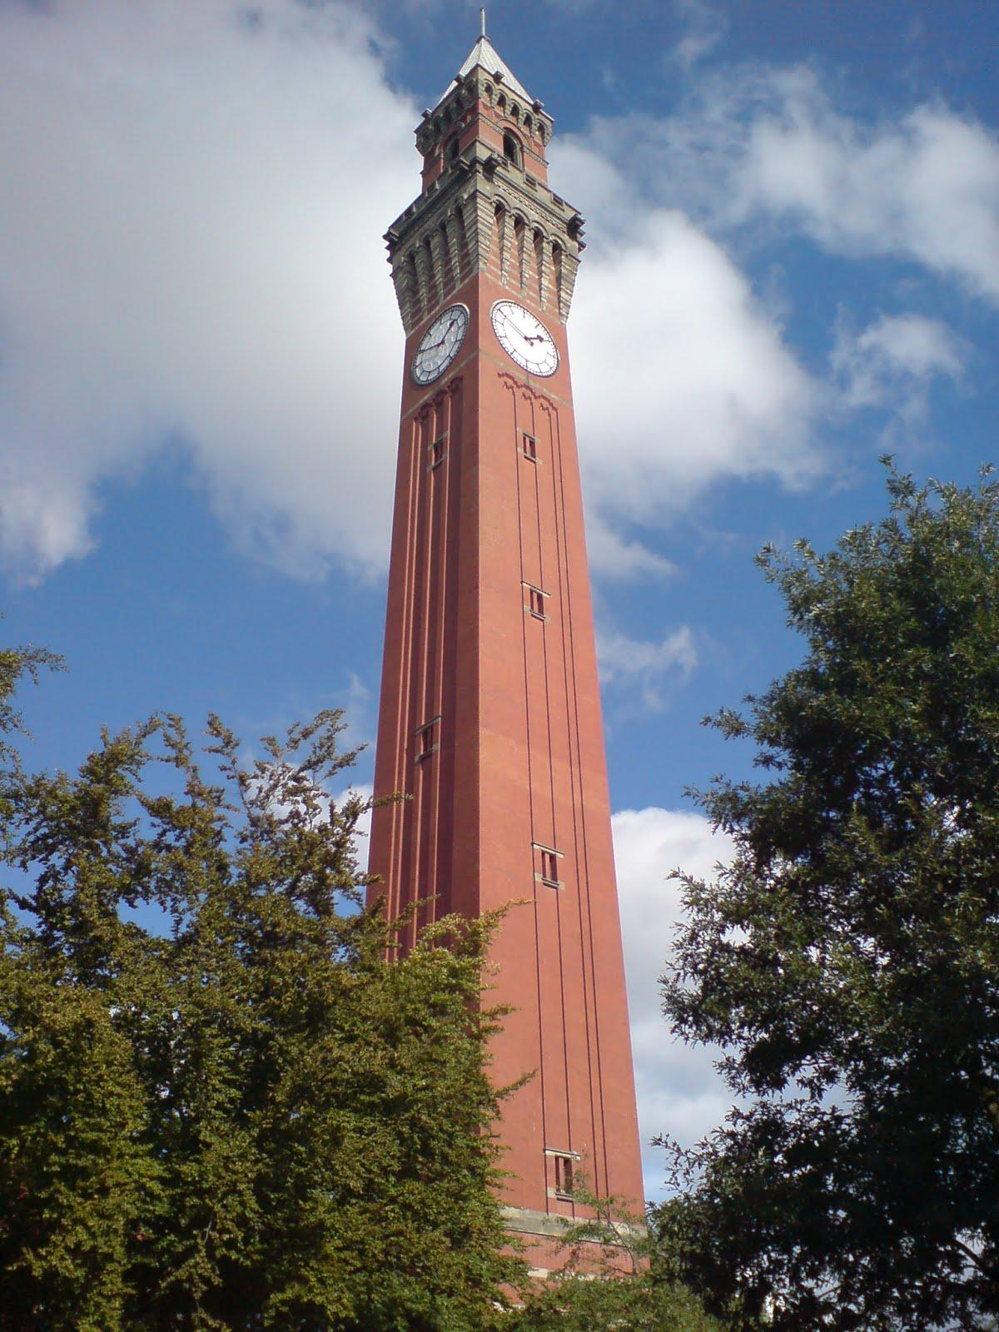
Architecture and Art
With the developments the second industrial revolution brought combined with the nationalist mindset of the time, architecture was becoming increasingly designed for aesthetics along with functionality
Art was now being incorporated into building for the first time since the Renaissance

